Slide 1
Chapter 2
C++ Basics

Slide 2
Introduction to C++ Programming
C++ programs contain a basic building block named a statement.
A statement could be an instruction or combination of instructions.
statement ends by semicolon ( e.g. int x; )
C++ is case sensitive ( i.e. A and a are different. )
The compiler ignores all spaces and new line.
E.g. Int x=5 is the same as after compiled.
Int x=5;

Slide 3
Preprocessor directives (#)
Before you can use any runtime libraries in your program, you must first add a header-file into your program, using the # include statement.
A header file is a file with an extension of .h that is included as part of a program and notifies the compiler that a program uses run-time libraries.
Preprocessor directives processed by preprocessor before compiling and begin with #
Example, #include <iostream.h> Tells preprocessor to include the input/output stream header file <iostream.h>

Slide 4
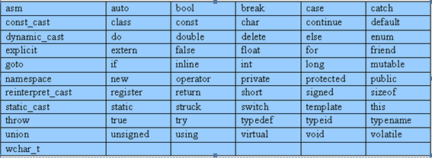
C++ keywords (Reserved words)
Reserved/Key words have a unique meaning within a C++ program.
Each keyword has a predefined purpose in the language.
Do not use keywords as variable and constant names!!
The following are some of the reserved words of C++.

Slide 5
C++ identifiers
  The C++ identifier is a name used to identify a variable, function, class, module, or any other user-defined item.
  It consists of a letter followed by any sequence of letters, digits, and underscores.
  The general rules for constructing names for variables (unique identifiers) are:
  Names can contain letters, digits and underscores
  Names must begin with a letter or an underscore (_)
  Names are case sensitive (myVar and myvar are different variables)
  Names cannot contain whitespaces or special characters like !, #, %, etc.
  Reserved words (like C++ keywords, such as int) cannot be used as names

Slide 6
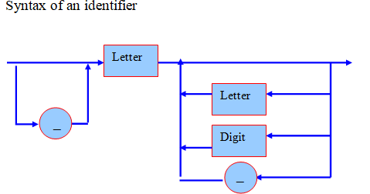
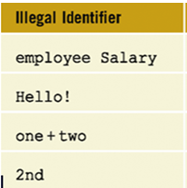
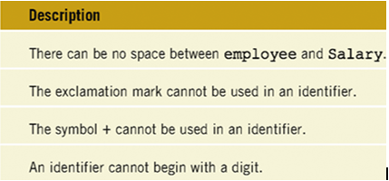
C++ identifiers cont..

Slide 7
C++ comments
Comments are explanatory notes
Program comments are totally ignored by the compiler and are only intended for human readers.
C++ provides two types of comment delimiters:
a. Single-line comment
Begin with //
Anything after // (until the end of the line on which it appears) is considered a comment.
Example // this is a text-printing program
b. Multi-line comment
Start with /*
End with */
Anything enclosed by the pair /* and */ is considered a comment.
Example /* This is a text-printing program*/

Slide 8
// A first program in C++
Comments
Written between /* and */ or following a //.
Improve program readability and do not cause the computer to perform any action.
#include <iostream>
int main()
{
preprocessor directive
Message to the C++ preprocessor.
Lines beginning with # are preprocessor directives.
#include <iostream> tells the preprocessor to include the contents of the file <iostream>, which includes input/output operations (such as printing to the screen).
cout << "Welcome to C++!\n";
return 0; // indicate that program ended successfully
}
C++ programs contain one or more functions, one of which must be main
Parenthesis are used to indicate a function
int means that main "returns" an integer value.
Welcome to C++!
Prints the string of characters contained between the quotation marks.
The entire line, including cout, the << operator, the string "Welcome to C++!\n" and the semicolon (;), is called a statement.
All statements must end with a semicolon.
return is a way to exit a function from a function.
return 0, in this case, means that the program terminated normally.
A left brace { begins the body of every function and a right brace } ends it.

Slide 9
// Printing a line with multiple statements
#include <iostream>
int main()
{
cout << "Welcome ";
cout << "to C++!\n";
return 0; // indicate that program ended successfully
}
Welcome to C++!
Unless new line '\n' is specified, the text continues on the same line.

Slide 10
// Printing multiple lines with a single statement
#include <iostream>
int main()
{
cout << "Welcome\nto\n\nC++!\n";
return 0; // indicate that program ended successfully
}
Welcome
to
C++!
Multiple lines can be printed with one statement.

Slide 11
// Addition program
#include <iostream>
int main()
{
int integer1, integer2, sum; // declaration
cout << "Enter first integer\n"; // ompt
Notice how cin is used to get user input.
cin >> integer1; // read an integer
cout << "Enter second integer\n"; // prompt
cin >> integer2; // read an integer
sum = integer1 + integer2; // assignment of sum
cout << "Sum is " << sum << endl; // print sum
endl flushes the buffer and prints a newline.
return 0; // indicate that program ended successfully
}
Enter first integer
45
Enter second integer
72
Sum is 117
Variables can be output using cout << variableName.

Slide 12
Variables
A variable is a symbolic name for a memory location in which data can be stored and subsequently recalled.
Variables are used for holding data values so that they can be changed and utilized in various computations in a program.
All variables have two important attributes:
  A type: which is, established when the variable is defined (e.g., integer, float, character).
    Once defined, the type of a C++ variable cannot be changed.
  A value: which can be changed by assigning a new value to the variable.
    The kind of values a variable can assume depends on its type.
    example, an integer variable can only take integer values (e.g., 2, 100, -12) not real numbers like 0.123.

Slide 13
Variable Declaration
Declaring a variable means defining (creating) a variable.
  You create or define a variable by stating its type, followed by one or more spaces, followed by the variable name and a semicolon.
  Syntax: Data_Type Variable_Name;
  Fore example:
    int year; //integer variable declaration, the variable name is year.
    char ch; //character variable declaration, the variable name is ch.
    float bonus; //floating number declaration, the variable name is bonus.
    The following statement defines an integer variable called myAge:
    int myAge;
    Variables must be declared before used!

Slide 14
Creating More Than One Variable at a Time
  You can create more than one variable of the same type in one statement by writing the type and then the variable names, separated by commas.
  Syntax: Data_Type Variable_Name1, Variable_Name2, …… Variable_NameN;
  For examples:
int myAge, myWeight; // two int variables
long area, width, length; // three longs
  you cannot mix types in one definition statement

Slide 15
Assigning Values to Your Variables
You assign a value to a variable by using the assignment operator (=).
Syntax: Data_Type Valid _Variable_Name;
Valid _Variable_Name = Initial _Value;
For examples:
int Width; //declaration
Width = 5; //assignment
OR
int Width = 5; //initialization
// create two int variables and initialize them
int width = 5, length = 7;
//mix definitions and initializations:
int myAge = 39, yourAge, hisAge = 40;

Slide 16
Basic Data Types
When you define a variable in C++, you must tell the compiler what kind of variable it is:
  This information tells the compiler how much room to set aside and what kind of value you want to store in your variable.
Several data types are built into C++.
  The varieties of data types allow programmers to select the type appropriate to the needs of the applications being developed.
The data types supported by C++ can be classified as
  basic (fundamental) data types
  user defined data types
  derived data types

Slide 17
Basic Data Types
Basic data types can be divided into:
  numeric and
  character types
Numeric variables can further be divided into
  integer variables – hold only integers
  floating-point variables – hold real numbers
Both the numeric data types offer modifiers that are used to vary the nature of the data to be stored.
  short
  long
  signed
  unsigned.

Slide 18
C++ data types and their ranges
Type | Size | Values
unsigned short int | 2 bytes | 0 to 65,535
short int(signed short int) | 2 bytes | -32,768 to 32,767
unsigned long int | 4 bytes | 0 to 4,294,967,295
long int(signed long int) | 4 bytes | -2,147,483,648 to 2,147,483,647
int | 4 bytes | -2147483648 to 2147483647
unsigned int | 2 bytes | 0 to 65,535
signed int | 2 bytes | -32,768 to 32,767
char | 1 byte | 256 character values
float | 4 bytes | 3.4e-38 to 3.4e38
double | 8 bytes | 1.7e-308 to 1.7e308
long double | 10 bytes | 1.2e-4932 to 1.2e4932

Slide 19
Characters
Character variables (type char) are typically 1 byte,
  enough to hold 256 values.
A char can be interpreted as a small number (0-255) or as a member of the ASCII set.
  ASCII - the American Standard Code for Information Interchange.
  The ASCII character set and its ISO (International Standards Organization) equivalent are a way to encode all the letters, numerals, and punctuation marks.
In the ASCII code, the lowercase letter "a" is assigned the value 97. All the lower- and uppercase letters, all the numerals, and all the punctuation marks are assigned values between 1 and 128.
  Another 128 marks and symbols are reserved for use by the computer maker, although the IBM extended character set has become something of a standard

Slide 20
Characters and Numbers
When you put a character, for example, `a', into a char variable, what is really there is just a number between 0 and 255.
The compiler knows how to translate back and forth between characters and one of the ASCII values.
There is a big difference between the value 5 and the character `5'.
  The latter is actually valued at 53

Slide 21
Constants
C++ introduces the concept of a named constant that is just like a variable, except that its value cannot be changed.
The qualifier const tells the compiler that a name represents a constant. Any data type, built-in or user-defined, may be defined as const.
If you define something as const and then attempt to modify it, the compiler will generate an error.
Example:
const float PI = 3.1416;
const double SALESTAX = 0.05;
const int MAXNUM = 100;
Once declared, a constant can be used in any C++ statement in place of the number it represents.

Slide 22
Input/Output Statements
The most common way in which a program communicates with the outside world is through simple, character-oriented Input/Output (IO) operations.
C++ provides two useful operators for text based output and input purpose:
  >> for input and
  << for output.
The cout object is an output object that sends data given to it to the standard output display device.
To send a message to the cout object, you use the following pattern:
cout <<"text“;
The cin object is an input object that accepts data from the standard input device.
To accept a message from the cin object, you use the following pattern: cin >>text;

Slide 23
#include <iostream.h>
int main (){
int workDays = 5;
float workHours = 7.5;
float payRate, weeklyPay;
cout << "What is the hourly pay rate? ";
cin >> payRate;
weeklyPay = workDays * workHours * payRate;
cout << "Weekly Pay = ";
cout << weeklyPay;
cout << '\n';
}

Slide 24
Operators
C++ provides operators for composing expressions
  arithmetic
  relational
  logical
  bitwise
It also provides operators which produce useful side-effects
  assignment
  increment
  decrement

Slide 25
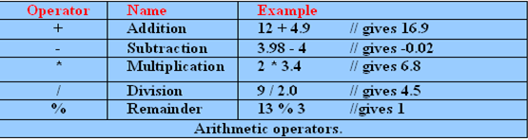
Arithmetic Operators
C++ provides five basic arithmetic operators.
Except for remainder (%) all other arithmetic operators can accept a mix of integer and real operands.
  Generally, if both operands are integers then the result will be an integer. However, if one or both of the operands are reals then the result will be a real (or double to be exact).
The remainder operator (%) expects integers for both of its operands.
  It returns the remainder of integer-dividing the operands.

Slide 26
Arithmetic …
Integer division always results in an integer outcome (i.e., the result is always rounded down). For example:
9 / 2 // gives 4, not 4.5!
It is illegal to divide a number by zero. This results in a run-time division-by-zero failure, which typically causes the program to terminate.

Slide 27
Assignment Operators
The assignment operator is used for storing a value at some memory location (typically denoted by a variable).
Its left operand should be an lvalue(left value), and its right operand may be an arbitrary expression.
  The latter is evaluated and the outcome is stored in the location denoted by the lvalue.
  An lvalue is anything that denotes a memory location in which a value may be stored.
The assignment operator has a number of variants obtained by combining it with the arithmetic operators.
Syntax:
<Variable Identifier> = < expression>;
Description: The <expression> is evaluated and the resulting value is stored in the memory space reserved for <variable identifier>.

Slide 28
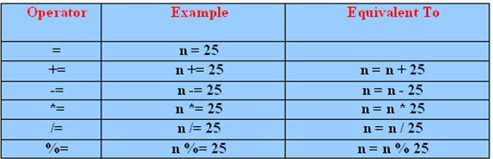
Assignment Operators …
Generally Assignment operator (=):
Assigns value on left to variable on right
Binary operator (two operands).
Example:
    int a= 5;
    float b= 9.66;
    char ch=‘d’

Slide 29
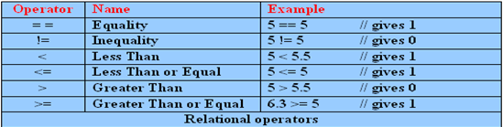
Relational Operators
C++ provides six relational operators for comparing numeric quantities.
Relational operators evaluate to 1 (true outcome) or 0 (false outcome).

Slide 30
Relational …
The operands of a relational operator must evaluate to a number.
Characters are valid operands since they are represented by numeric values.
'A' < 'F' // gives 1 (is like 65 < 70)
The relational operators should not be used for comparing strings, because this will result in the string addresses being compared, not the string contents.
C++ provides library functions (e.g., strcmp) for the lexicographic comparison of string.

Slide 31
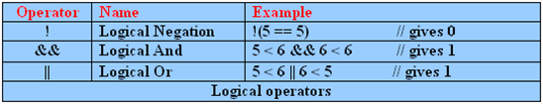
Logical Operators
C++ provides three logical operators for combining logical expression.
Like the relational operators, logical operators evaluate to 1 or 0.
Logical negation is a unary operator, which negates the logical value of its single operand.
  If its operand is nonzero it produces 0, and if it is 0 it produces 1.

Slide 32
Logical …
Logical and produces 0 if one or both of its operands evaluate to 0. Otherwise, it produces 1.
Logical or produces 0 if both of its operands evaluate to 0. Otherwise, it produces 1.
valid logical expressions:
  !20 // gives 0
  10 && 5 // gives 1
  10 || 5.5 // gives 1
  10 && 0 // gives 0
C++ does not have a built-in boolean type. It is customary to use the type int for this purpose instead.
For example:
int sorted = 0; // false
int balanced = 1; // true

Slide 33
Bitwise Operators
Bitwise operator works on bits and performs bit-by-bit operation.
Assume a=12 and b=25
Operator | Description | Example
| (bitwise OR) | compares corresponding bits of two operands. If either of the bits is 1, it gives 1. If not, it gives 0. | a|b=29
&(bitwise AND) | If both bits are 1, it gives 1. If either of the bits is not 1, it gives 0. | a&b=8
~(bitwise complement) | inverts the bit pattern. It makes every 0 to 1, and every 1 to 0. | ~a=11110011
^(bitwise XOR) | If corresponding bits are different, it gives 1. If corresponding bits are same, it gives 0. | a^b=21
<<(left shift) | shifts a bit pattern to the left by certain number of specified bits | a<<1=24
>>(right shift) | shifts a bit pattern to the right by certain number of specified bits. | a>>1=6

Slide 34
Bitwise …
Bitwise operators expect their operands to be integer quantities and treat them as bit sequences.
  Bitwise negation is a unary operator which reverses the bits in its operands.
  Bitwise and compares the corresponding bits of its operands and produces a 1 when both bits are 1, and 0 otherwise.
  Bitwise or compares the corresponding bits of its operands and produces a 0 when both bits are 0, and 1 otherwise.
  Bitwise exclusive or compares the corresponding bits of its operands and produces a 0 when both bits are 1 or both bits are 0, and 1 otherwise.
  Bitwise left shift operator and bitwise right shift operator both take a bit sequence as their left operand and a positive integer quantity n as their right operand.
    The former produces a bit sequence equal to the left operand but which has been shifted n bit positions to the left.
    The latter produces a bit sequence equal to the left operand but which has been shifted n bit positions to the right. Vacated bits at either end are set to 0.

Slide 35
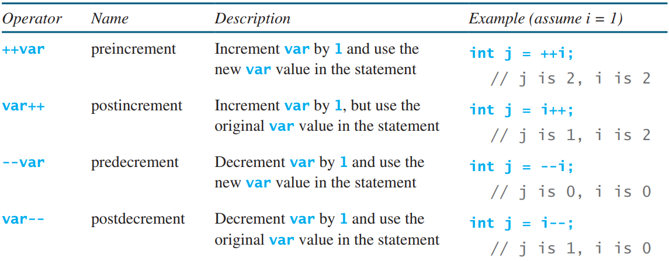
Increment/decrement Operators
The auto increment (++) and auto decrement (--) operators provide a convenient way of, respectively, adding and subtracting 1 from a numeric variable.

Slide 36
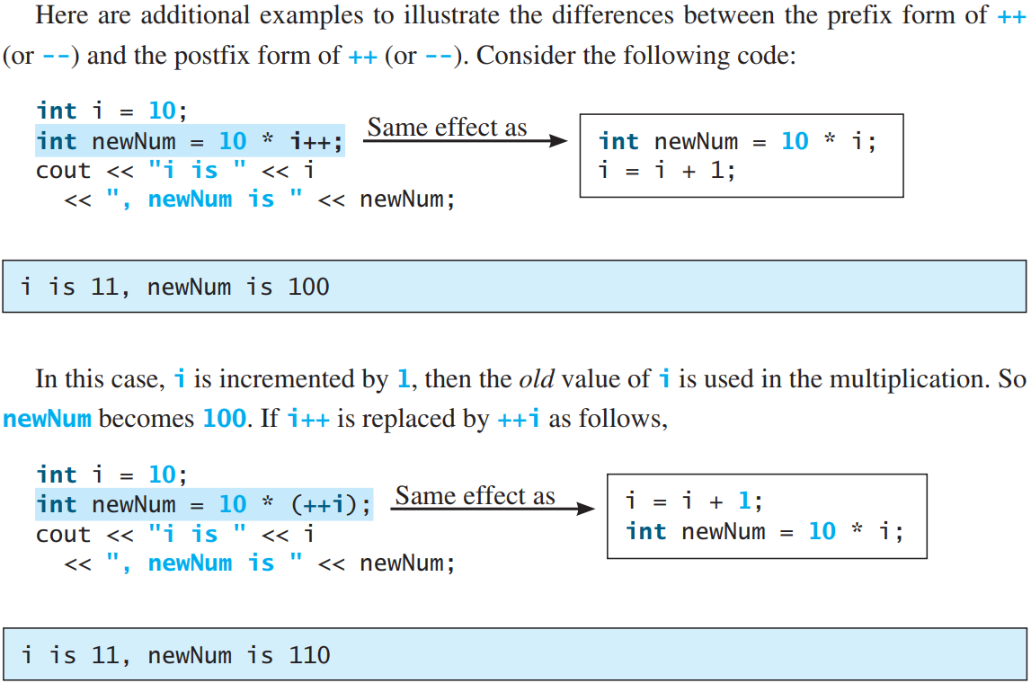
Increment/decrement Operators …

Slide 37
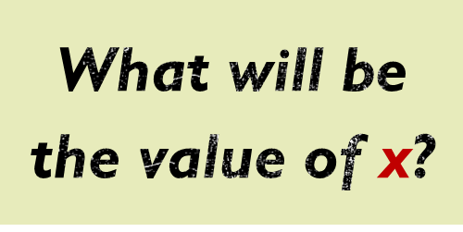
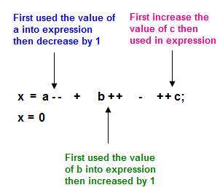
Increment/decrement Operators …
int x, a, b, c;
a = 2;
b = 4;
c = 5;
x = a-- + b++ - ++c;

Slide 38
Precedence of Operators
The order in which operators are evaluated in an expression is significant and is determined by precedence rules.
These rules divide the C++ operators into a number of precedence levels.
Operators in higher levels take precedence over operators in lower levels.

Slide 39
Level |  |  |  |  | Operator |  |  |  |  |  |  | Kind | Order
Highest | :: |  |  |  |  |  |  |  |  |  |  | Unary | Both
 | ( ) | [ ] | → |  |  | . |  |  |  |  |  | Binary | Left to Right
 | + - | ++ -- | ! ~ |  |  | * & | new delete |  |  | sizeof() |  | Unary | Right to Left
 | ->* | .* |  |  |  |  |  |  |  |  |  | Binary | Left to Right
 | * | / | % |  |  |  |  |  |  |  |  | Binary | Left to Right
 | + | - |  |  |  |  |  |  |  |  |  | Binary | Left to Right
 | << | >> |  |  |  |  |  |  |  |  |  | Binary | Left to Right
 | < | <= | > |  |  | >= |  |  |  |  |  | Binary | Left to Right
 | == | != |  |  |  |  |  |  |  |  |  | Binary | Left to Right
 | & |  |  |  |  |  |  |  |  |  |  | Binary | Left to Right
 | ^ |  |  |  |  |  |  |  |  |  |  | Binary | Left to Right
 | | |  |  |  |  |  |  |  |  |  |  | Binary | Left to Right
 | && |  |  |  |  |  |  |  |  |  |  | Binary | Left to Right
 | || |  |  |  |  |  |  |  |  |  |  | Binary | Left to Right
 | ? : |  |  |  |  |  |  |  |  |  |  | Ternary | Left to Right
 | = | += -= | *= /= |  |  | ^= %= | &= |= |  |  | <<= >>= |  | Binary | Right to Left
Lowest | , |  |  |  |  |  |  |  |  |  |  | Binary | Left to Right
Chapter 2: C++ Basics Comp221:

Slide 40
Precedence of Operators
a + b + c + d + e
a + b * c - d / e
1
2
3
4
3
1
4
2
a / (b + c) - d % e
2
1
4
3
a / (b * (c + (d - e)))
4
3
2
1
Example: Evaluate the following expressions
3 + 2 * 3 → 9
(3 + 2) * 3 → 15
23 + 4 * 5 /2 % 3-7 → 17

Slide 41
Simple Type Conversion
C++ allows us to convert data of one type to that of another.
This is known as type conversion.
here are two types of type conversion in C++.
Implicit Conversion
Explicit Conversion (also known as Type Casting)
Implicit Type Conversion
This type of conversion is also known as automatic conversion.
For example:
int num_int = 9;
double num_double;
num_double = num_int;
double num_double = 9.99;
int num_int;
num_int = num_double;

Slide 42
Simple Type Conversion…
Explicit Conversion
When the user manually changes data from one type to another
Syntax:
(type) expression
For example,
double x = 1.2;
int sum = (int)x + 1;
  (int) 3.14 // converts 3.14 to an int to give 3
  (double) 2 // converts 2 to a double to give 2.0

Slide 43
Exercise
Write a statement (or comment) to accomplish each of the following:
  State that a program calculates the product of three integers.
  Declare the variables x, y, z and result to be of type int.
  Prompt the user to enter three integers.
  Read three integers from the keyboard and store them in the variables x, y and z.
  Compute the product of the three integers contained in variables x, y and z, and assign the result to the variable result.
  Print "The product is " followed by the value of the variable result.
  Return a value from main indicating that the program terminated successfully.

Slide 44
Exercise
2. Write a program that accepts two integers and display the sum, difference, product and division of the two numbers. The program should also state the greater and smaller number.

Slide 45
Exercise
3. Write a program that calculate and display the circumference of a circle. (C = 2∏r )

Slide 46
Exercise
4. Write a program to solve a quadratic equation.
Hint: y = ax² + bx + c
root = (-b ± sqrt(b² -4ac)) / 2a
  Note: include math.h to use square root function(sqrt(double))

